Slide 1


Year 1 Autumn Scheme of Learning

Slide 2
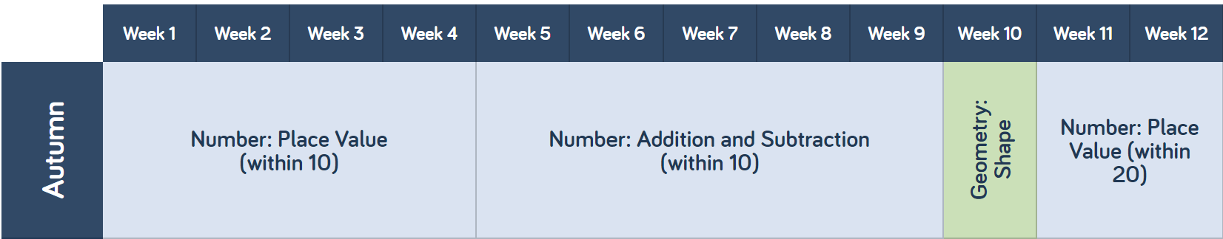
Year 1

Slide 3
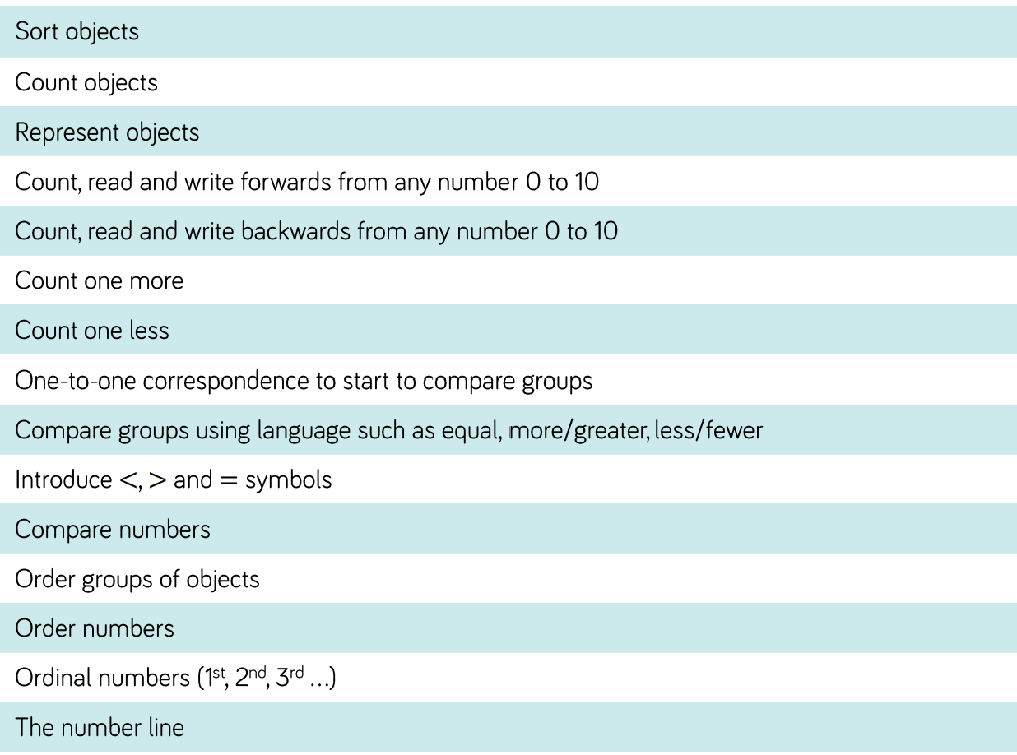
Year 1

Slide 4
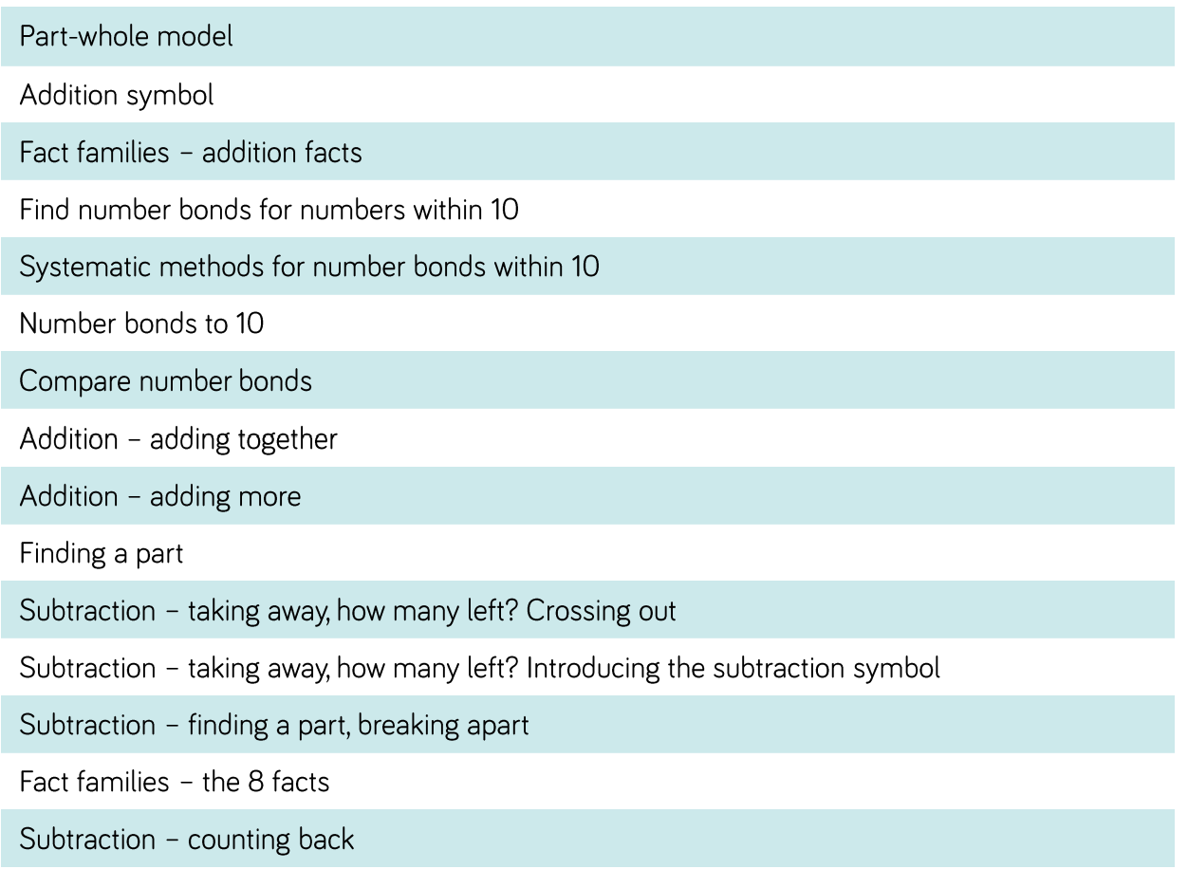
Year 1

Slide 5
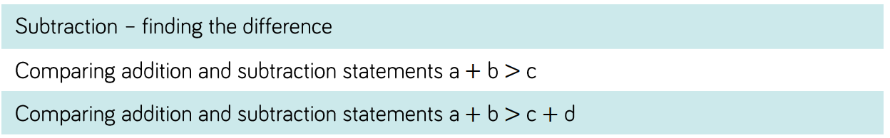
Year 1

Slide 6
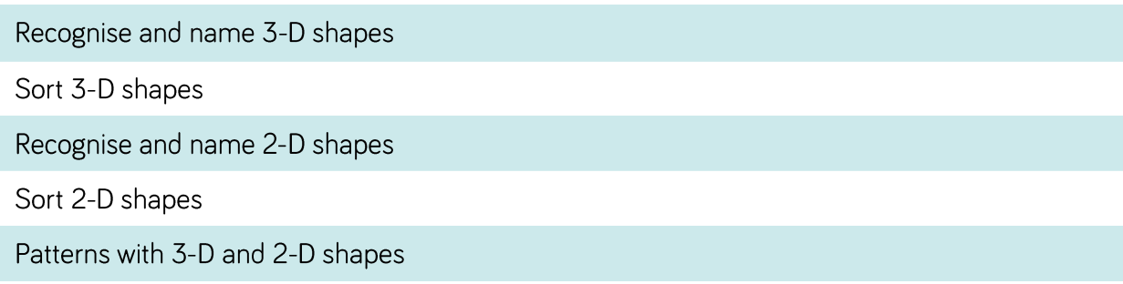
Year 1

Slide 7
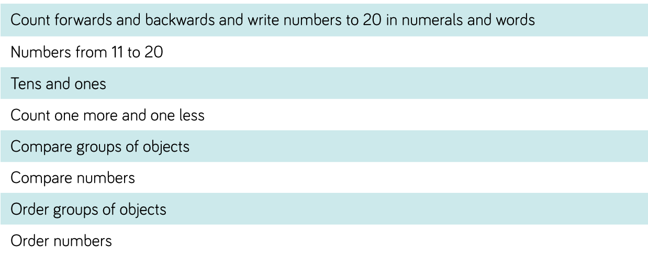
Year 1

